Slide 1
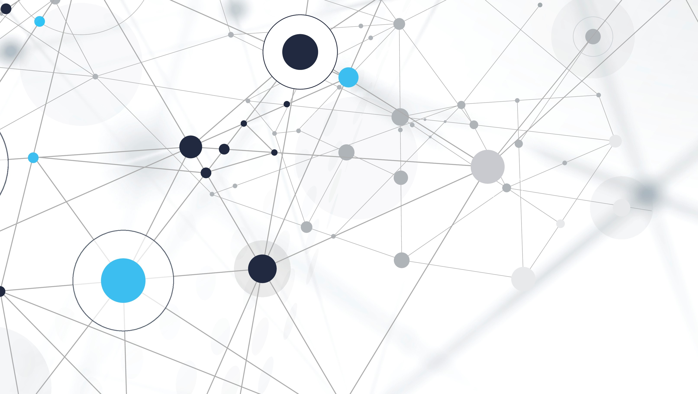
ENTITY RELATIONSHIP MODEL
Database Management -Prof. Manish Khare
TA’s – Samiksha , Arjun, Naisargi, Ishant

Slide 2
Entity Relationship Model :
Entity Relationship Model (ER) data model is based on a perception of a real world that consists of a set of basic objects called entities and of relationships among these objects.
It was developed to facilitate database design by allowing the specification of an enterprise scheme, which represents the overall logical structure of a database.

Slide 3
Basic Concepts :
There are three basic notations that the E-R data model involves – entity sets, attributes and relationship sets.
Entity Relationship (ER) modeling :
is a design tool
is a graphical representation of the database system
provides a high-level conceptual data model
supports the user’s perception of the data
is DBMS and hardware independent
had many variants
is composed of entities, attributes, and relationships

Slide 4
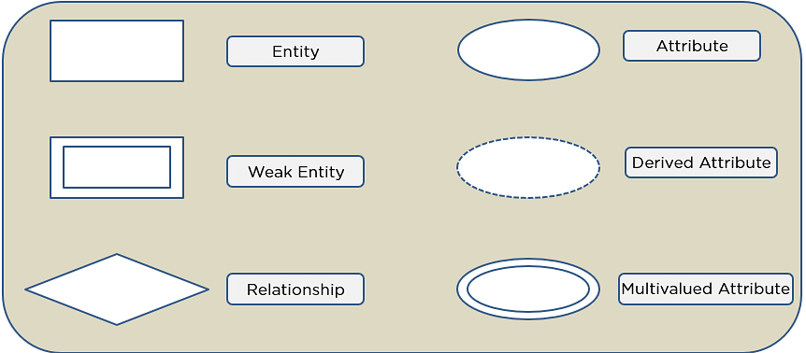
Symbols Used in ER Diagrams
Rectangles: This Entity Relationship Diagram symbol represents entity types
Ellipses: This symbol represents attributes
Diamonds: This symbol represents relationship types
Lines: It links attributes to entity types and entity types with other relationship types
Primary key: Here, it underlines the attributes
Double Ellipses: Represents multi-valued attributes

Slide 5
Components of ER Diagram
You base an ER Diagram on three basic concepts:
Entities
Weak Entity
Attributes
Key Attribute
Composite Attribute
Multivalued Attribute
Derived Attribute
Relationships
One-to-One Relationships
One-to-Many Relationships
Many-to-One Relationships
Many-to-Many Relationships

Slide 6
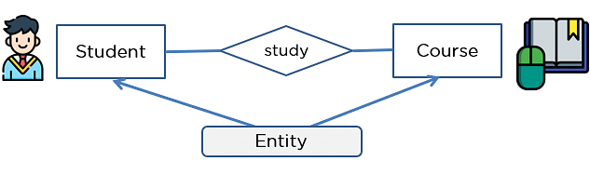
Entities
An entity can be either a living or non-living component.
It showcases an entity as a rectangle in an ER diagram.
For example, in a student study course, both the student and the course are entities.

Slide 7
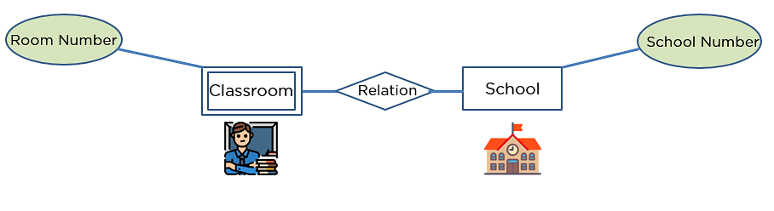
Weak Entity
An entity that makes reliance over another entity is called a weak entity
You showcase the weak entity as a double rectangle in ER Diagram.
In the example below, school is a strong entity because it has a primary key attribute - school number. Unlike school, the classroom is a weak entity because it does not have any primary key and the room number here acts only as a discriminator.

Slide 8
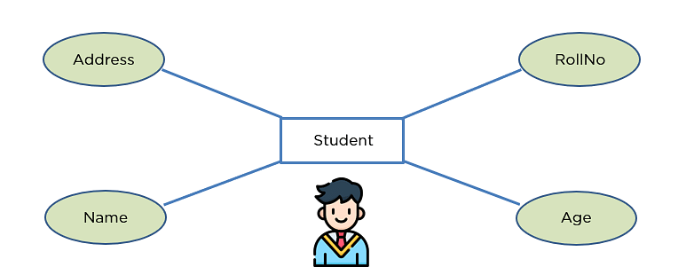
Attribute
An attribute exhibits the properties of an entity.
You can illustrate an attribute with an oval shape in an ER diagram.

Slide 9
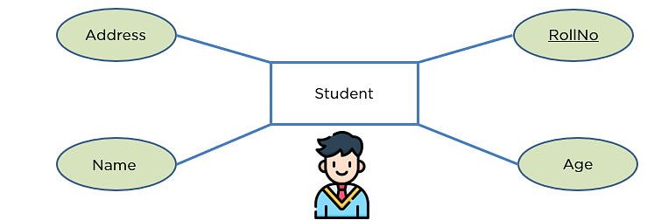
Key Attribute
Key attribute uniquely identifies an entity from an entity set.
It underlines the text of a key attribute.
For example: For a student entity, the roll number can uniquely identify a student from a set of students.

Slide 10
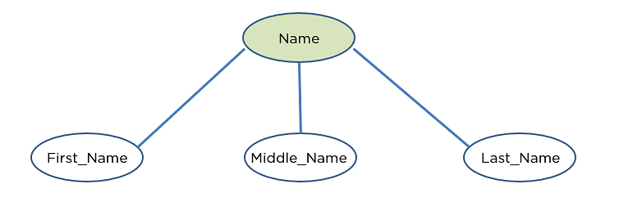
Composite Attribute
An attribute that is composed of several other attributes is known as a composite attribute.
An oval showcases the composite attribute, and the composite attribute oval is further connected with other ovals.

Slide 11
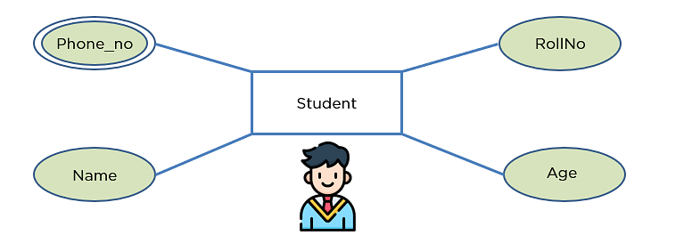
Multivalued Attribute
Some attributes can possess over one value, those attributes are called multivalued attributes.
The double oval shape is used to represent a multivalued attribute.

Slide 12
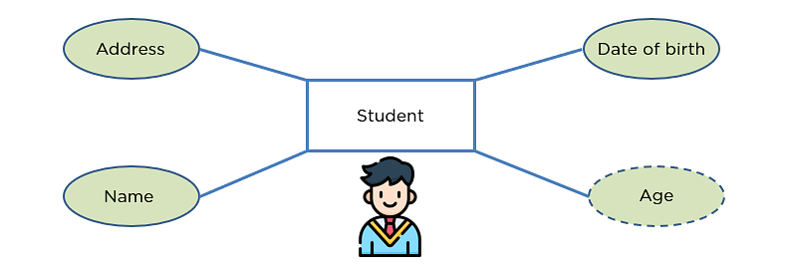
Derived Attribute
An attribute that can be derived from other attributes of the entity is known as a derived attribute.
In the ER diagram, the dashed oval represents the derived attribute.

Slide 13
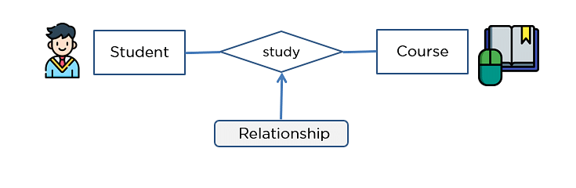
Relationship
The diamond shape showcases a relationship in the ER diagram.
It depicts the relationship between two entities.
In the example below, both the student and the course are entities, and study is the relationship between them.

Slide 14

One-to-One Relationship
When a single element of an entity is associated with a single element of another entity, it is called a one-to-one relationship.
For example, a student has only one identification card and an identification card is given to one person.

Slide 15
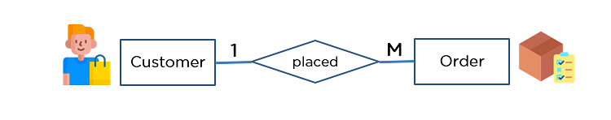
One-to-Many Relationship
When a single element of an entity is associated with more than one element of another entity, it is called a one-to-many relationship
For example, a customer can place many orders, but an order cannot be placed by many customers.

Slide 16

Many-to-One Relationship
When more than one element of an entity is related to a single element of another entity, then it is called a many-to-one relationship.
For example, students have to opt for a single course, but a course can have many students.

Slide 17
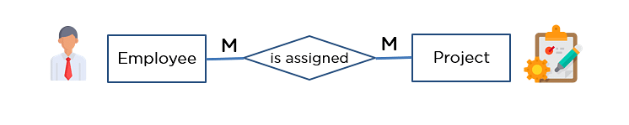
Many-to-Many Relationship
When more than one element of an entity is associated with more than one element of another entity, this is called a many-to-many relationship.
For example, you can assign an employee to many projects and a project can have many employees.

Slide 18
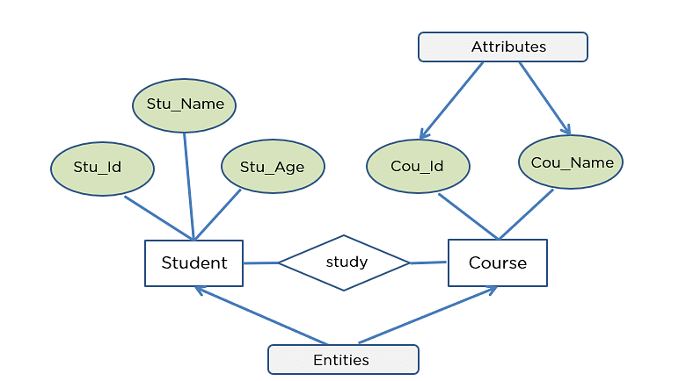
Student enrolled in course

Slide 19
Thank you so much

